Slide 1

McGill cool kids Team Rep 2022-2023
By Vanessa Xu
Inspired by Nic Germain

Slide 2
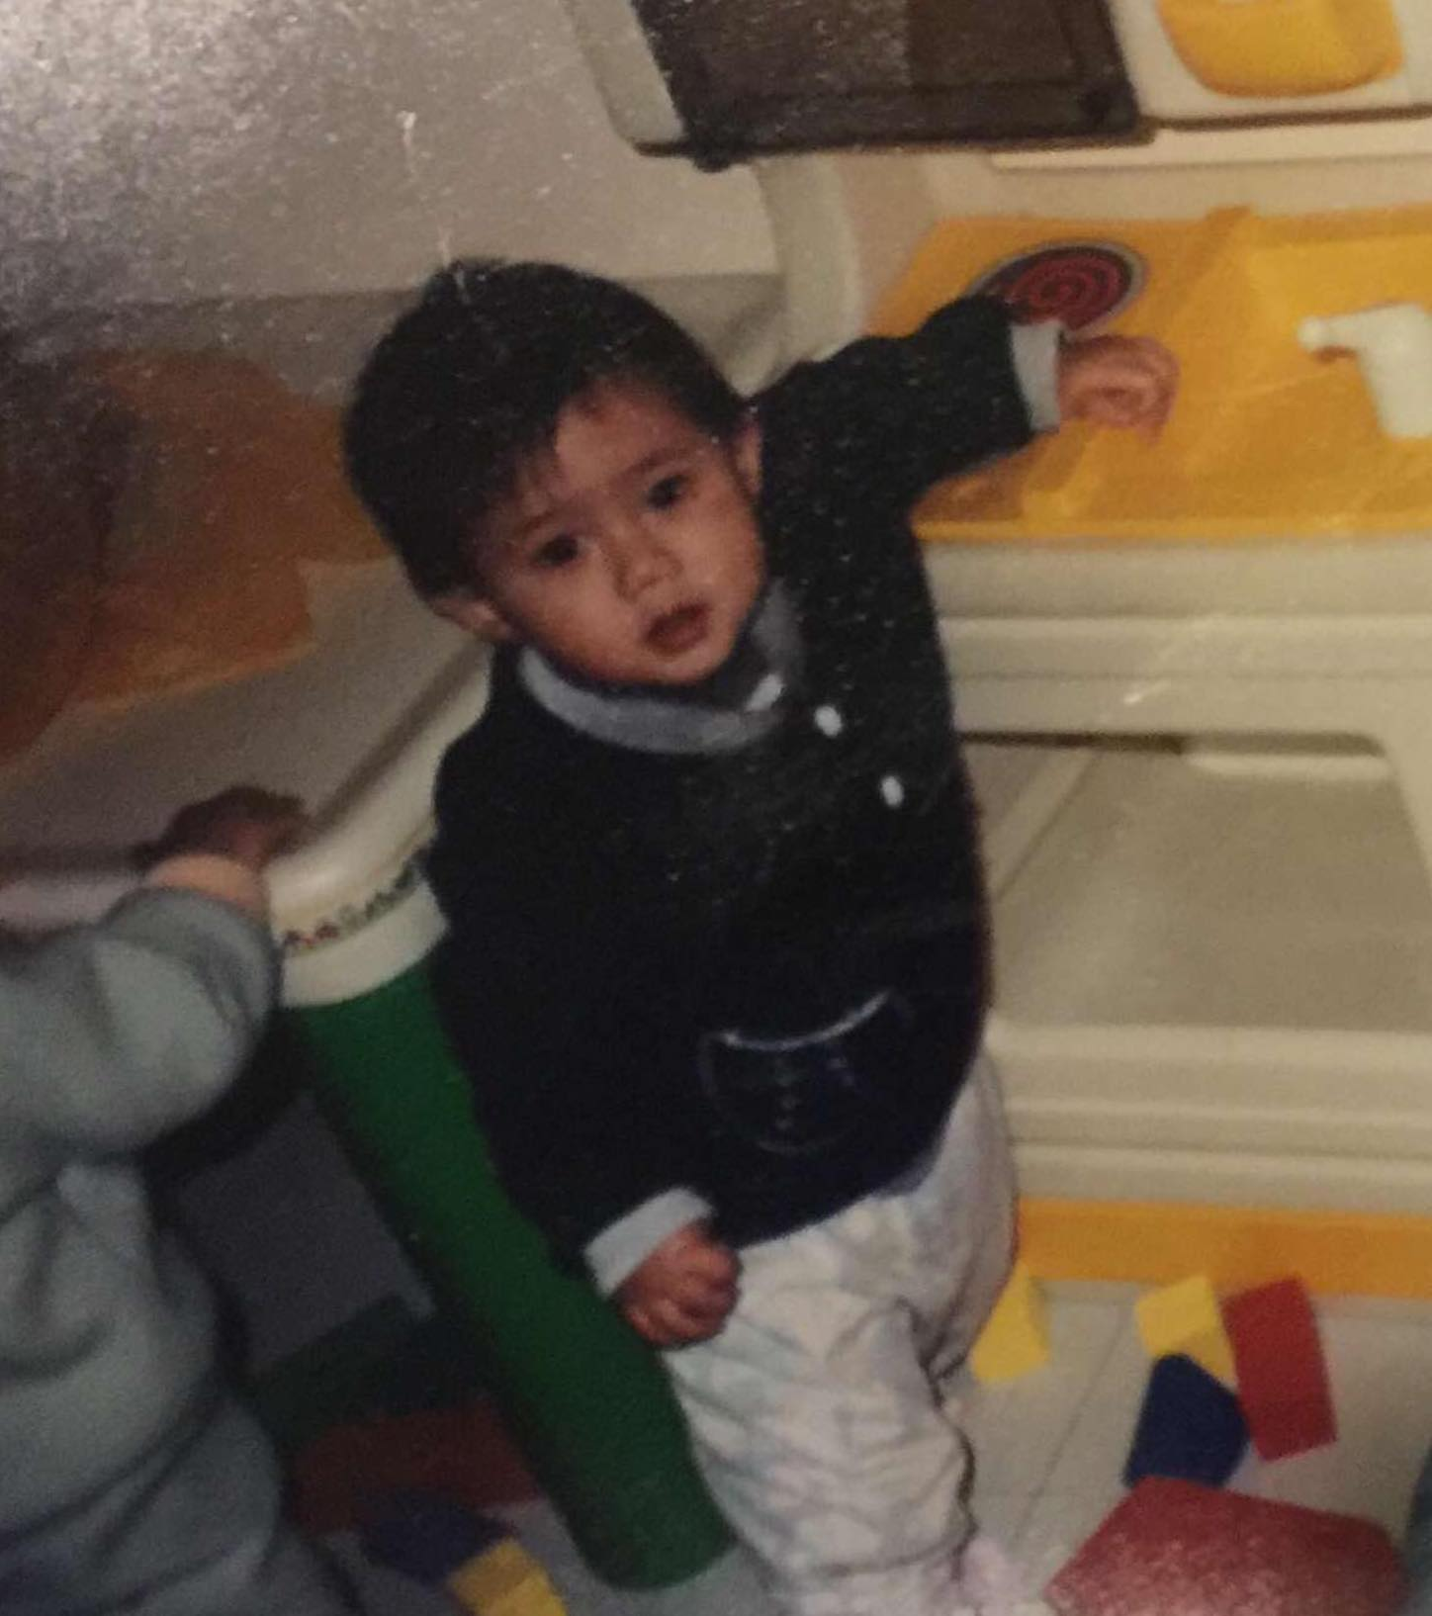
A bit about myself
Born and raised in beautiful, construction-filled montreal
Been playing badminton for 9 years
speaks English, French, and Cantonese (kinda)
U2 in chemical engineering (chen if you see this please TA my classes, thanks ☺)
Did a year in physiology
Am the younger and better sibling of our captain Joshua

Slide 3

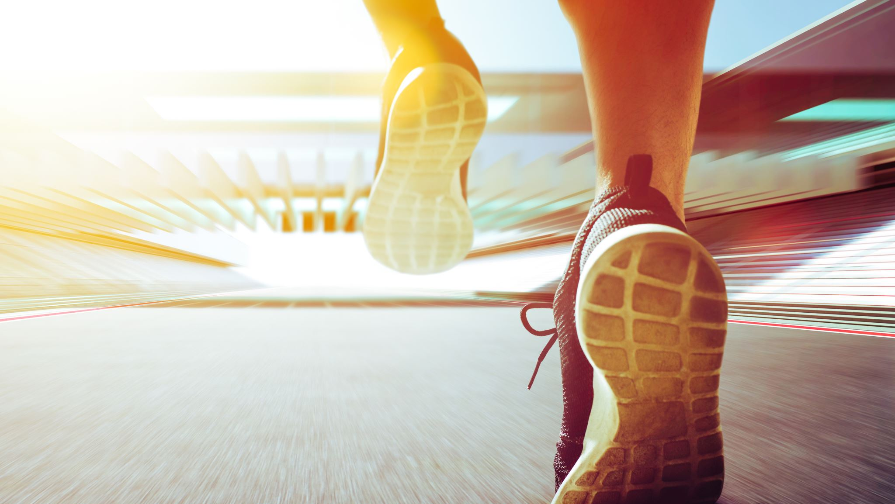
Reasons why I’m running for team rep

Slide 4
#1
Make Badminton a bigger part of mcgill varsity (show them how cool we are)
Ex: Get our team more involved with the other varsity teams, get more social media coverage

Slide 5
#2
Campaign to get us better training conditions
Ex: better training hours, wax the freaking floor so that our players don’t injure themselves, new nets

Slide 6
#3
Take part in creative thinking to make our varsity experience better
Or pass on any ideas that you guys might have

Slide 7

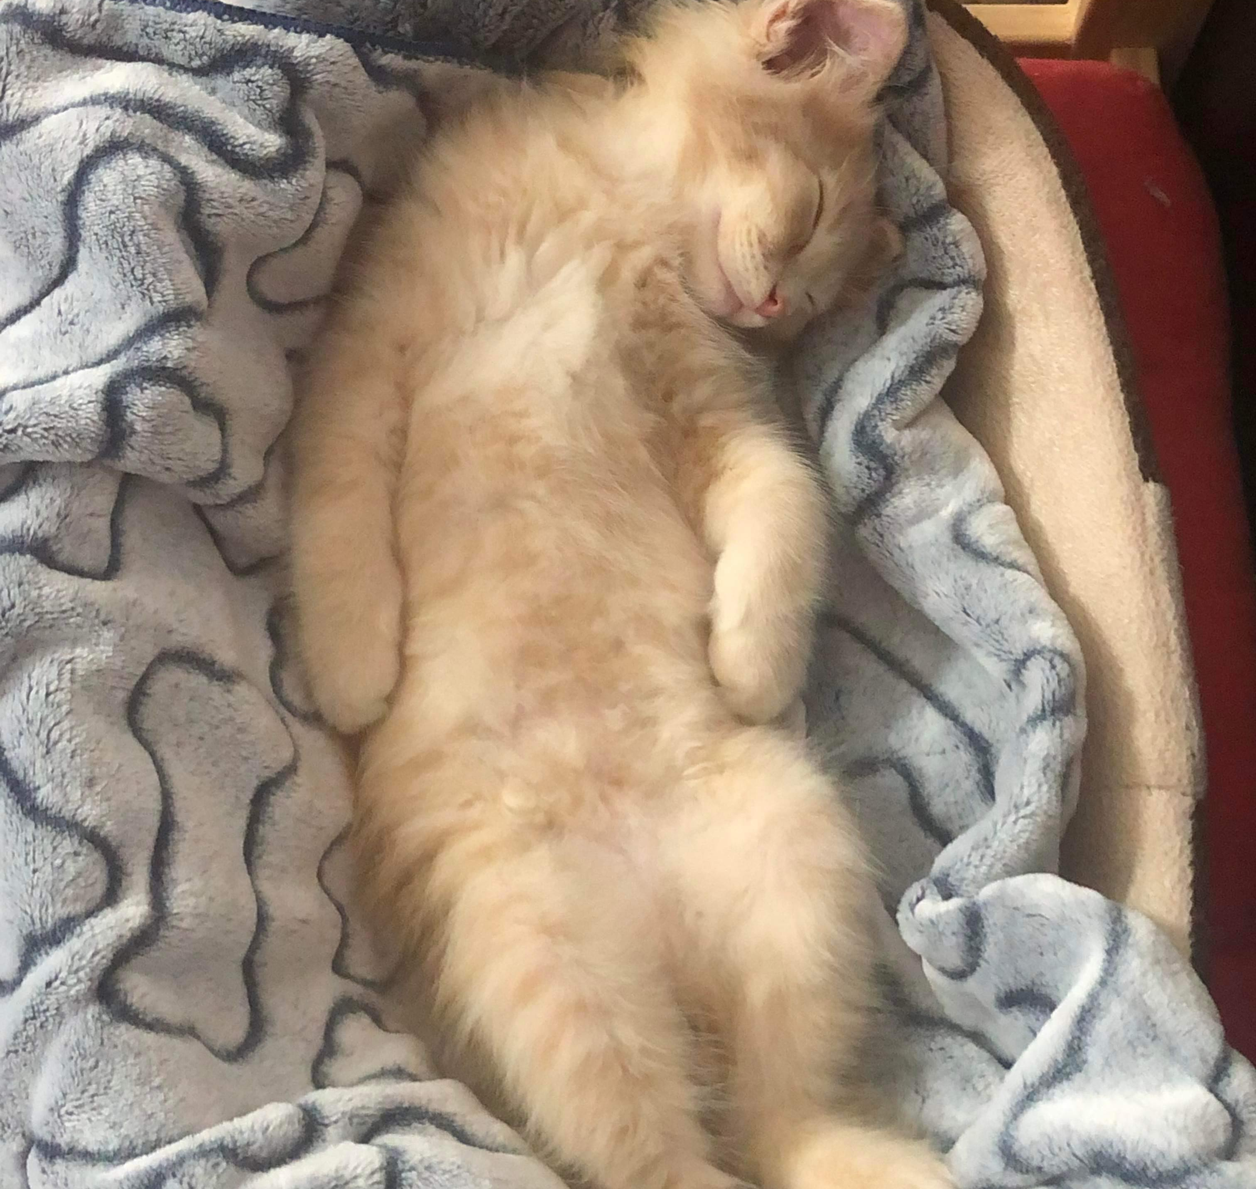
If you vote for me I’ll send you cat pictures

Slide 8

Thanks for reading !

